Slide 1

Clustering Analysis
Notes:
‹#›

Slide 2
Objectives
What is unsupervised learning?
What is clustering analysis?
How does k-means work?
How does DBSCAN work?
When to use clustering analysis?

Slide 3
What is Unsupervised Learning?
Branch of machine learning.
Models are trained on unlabeled data sets, otherwise known as having no ground truth.
There are no labels that describe the datasets.
Typically used to analyze and cluster unlabeled datasets.
Utilized to find patterns and identify groupings of data without being told by the programmer.

Slide 4
What is Clustering Analysis?
Clustering is utilized to find structure in data.
Determine whether the data forms groups and understand what the groupings mean.
Objective: structure the samples into clusters to understand what the samples are based on their groupings.
May be difficult to identify clusters and select the algorithm that will work optimally.
Unsupervised machine learning algorithms: k-means, DBSCAN.

Slide 5
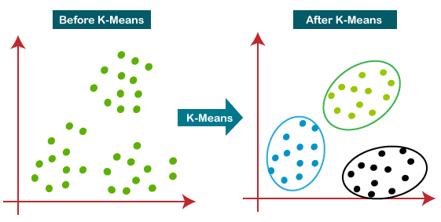
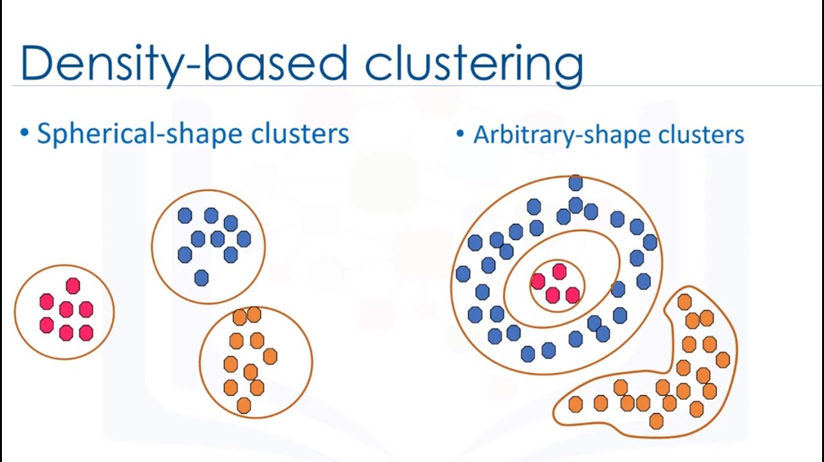
K-means vs. DBSCAN

Slide 6
How Does k-means Work?
Assumption: samples form round clusters.
Initial center points are spread out by the algorithm.
Steps:
Randomly choose a number of clusters (N clusters).
Randomly choose N center points.
Each sample should be assigned to the nearest center point.
The center point should be moved until it is at the center of the cluster.
The preceding two steps should be repeated until there is no more movement in the data.

Slide 7
How Does DBSCAN Work?
DBSCAN: Density-Based Spatial Clustering of Applications with Noise.
Assumption: samples within close proximity should be placed together.
Unlike k-means, no need to assume the number of clusters and controls how close samples are required to be.
DBSCAN places samples into three different categories:
Core points are points that are surrounded by a minimum number of points within an epsilon distance.
Border points are points that are in reachable distance from a core point and have less than the specified minimum number of points in the surrounding area.
Outliers are points that are not core points and are not within close proximity to any core points.

Slide 8
When to Use Clustering Analysis?
When using a dataset that contains no ground truth (labeled data).
When there are no assumptions made about the relationship within the data, clustering analysis will work well.
Clustering analysis should be used when information regarding patterns or associations in the data are to be discovered and understood.

